Slide 1
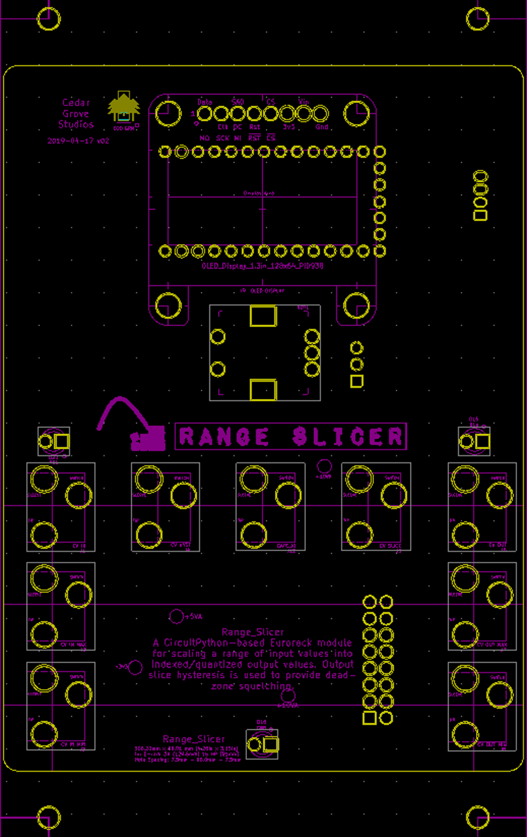
RANGE SLICER
CV COMPANDER
select
RANGE
INDEX
IN
GATE
HYST
STEPS
OUT
MAX
MAX
MIN
MIN

Slide 2
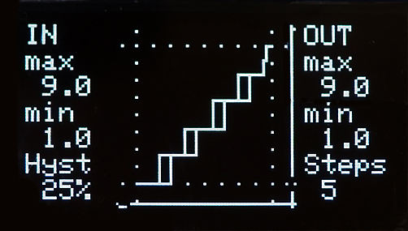
RANGE SLICER
CV COMPANDER
select
RANGE
INDEX
IN
GATE
HYST
STEPS
OUT
MAX
MAX
MIN
MIN

Slide 3
RANGE SLICER

Slide 4
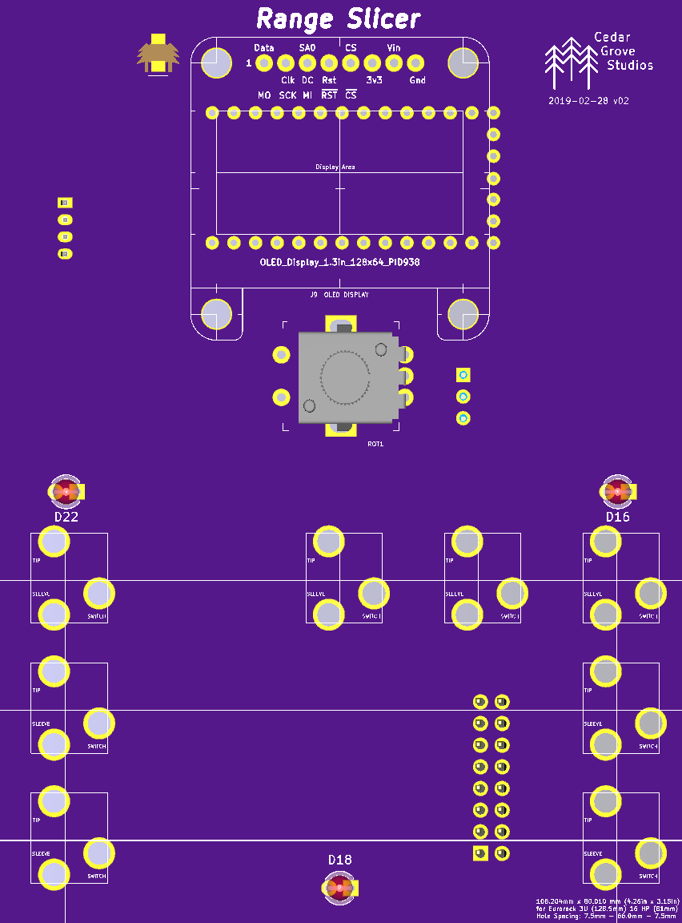
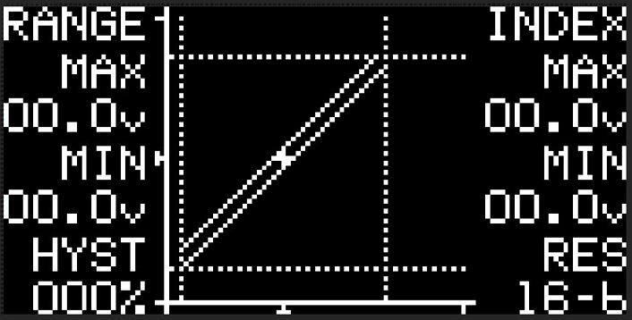
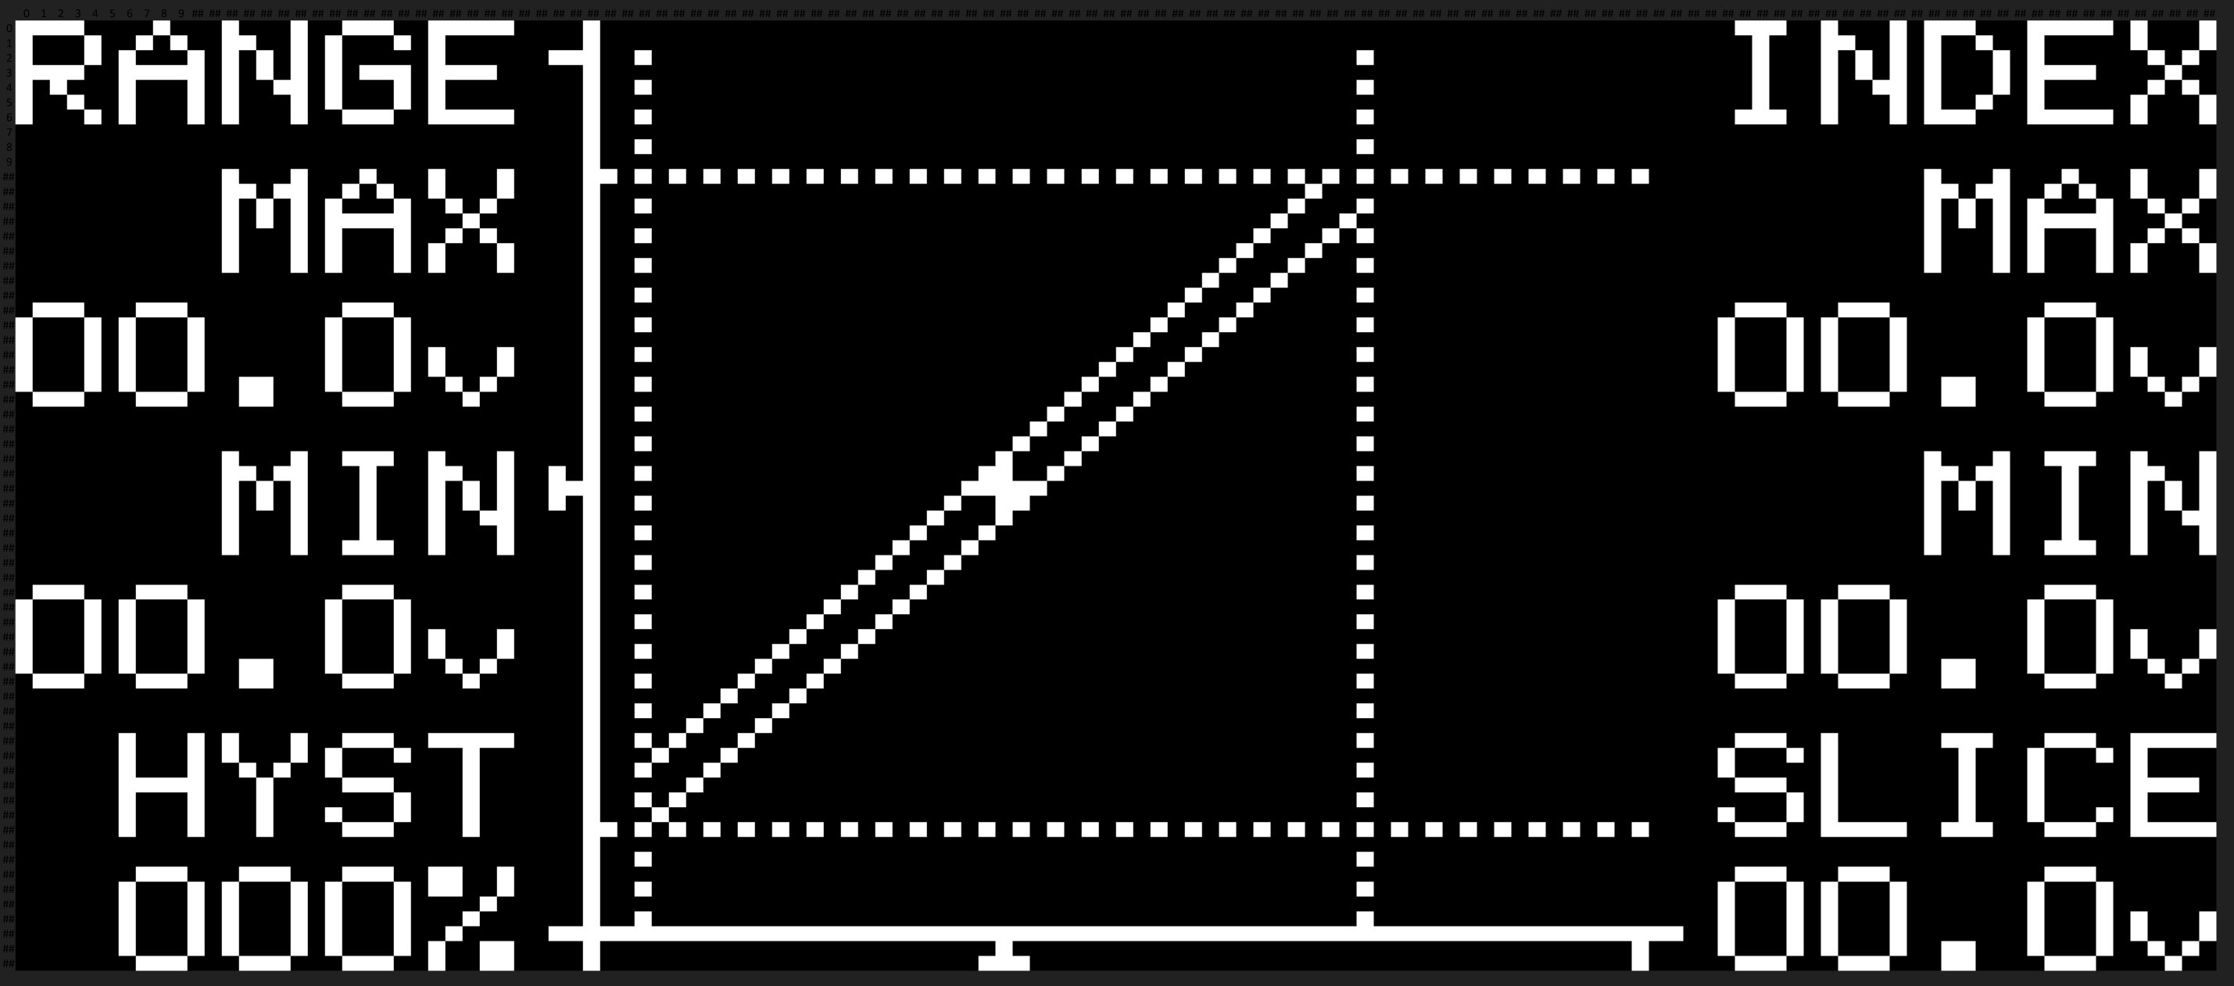
RANGE SLICER
CV COMPANDER
RANGE
INDEX
select
IN
HYST
SLICE
OUT
MAX
MAX
MIN
Cedar
Grove
MIN

Slide 5
RANGE SLICER
CV COMPANDER
RANGE
INDEX
select
IN
HYST
SLICE
OUT
MAX
MAX
MIN
Cedar
Grove
MIN

Slide 6
RANGE_INDEX
CV COMPANDER
MAX
MAX
PATTERN
RANGE
INDEX
MIN
MIN
PORTAL
INPUT
select
OUTPUT
25
75
stuff happens
0
100
POWER
% HYSTERESIS
inMAX
cvHYSTERESIS
outMAX
inMIN
cvSLICE
outMIN
Cedar
Grove

